Slide 1
Build and Deploy your Own Website
Microsoft Student Technical Clubs

Slide 2
What we’ll be covering today
HTML
Need and Importance
Structure and Syntax
Important Elements
CSS
Need and Importance
Syntax
Properties and Styling

Slide 3
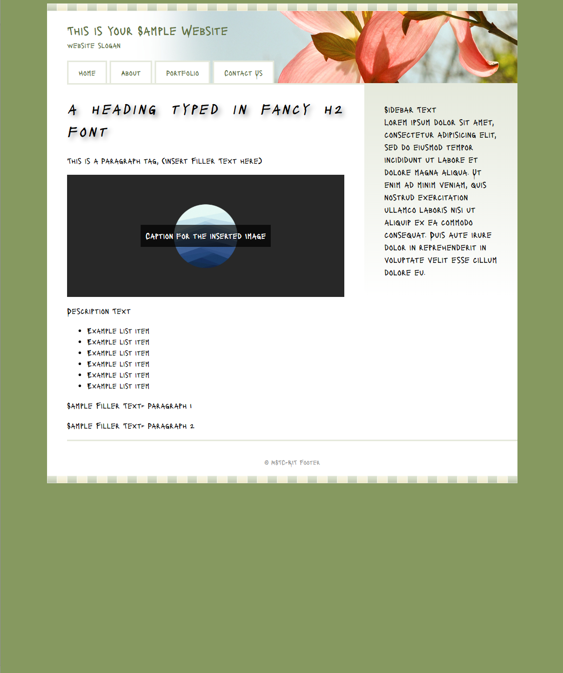

Slide 4
HTML

Slide 5
What is HTML
HyperText Markup Language
It is the Language in which Webpages are written in
We don’t need any Special Software to create simple Webpages
HTML Webpages are made up of several elements
HTML is used for Content on Webpages

Slide 6
Demo
Introduction to HTML

Slide 7
Notes (hidden)
Introduce them to codepen
Help them with a “Hello World” webpage
Explain <title>, <head> and <body> tags
Use Mainly <h1>, <h2> and <p>
Or, Do it offline (notepad, textedit or text editor)
Emphasize that they’re not supposed to use a word processor and that they should save it as a .html file
FOR MAC USERS, format>Make Plain Text (Cmd+Shft+T)
NEXT: html tags

Slide 8
Important HTML Tags
Head
This is where we include information regarding our document.
This is the section where we link all other files that are related to our .html file.
This is the section where we use the <title> tag and also state the <meta> tag preferences.
Body
It is where the content of our Webpage is Typed.
It is the main block of a Webpage.
Meta (Character Encoding Information)
This tells the Web Browser what Character Set we want access to in our Web Browser.
Unified Text Format.
“utf-8” includes English characters.

Slide 9
Note:
This marks the first time you’ve seen an HTML Attribute
As in, We’ve used the = sign and given a parameter within “”
<!DOCTYPE html>
This tells the Browser that we would like to use Modern HTML and not any other old version of HTML

Slide 10
Other HTML Tags
Heading Levels: <h1> to <h6>
Anchor Tag: <a>
Text Related: <b> <u> <i>
Paragraph Tag: <p>
Ordered List: <ol> <li>
Unordered List: <ul> <li>
Comments: <!-- type comment here -->

Slide 11
Demo
How to Add Links and Media to our Webpage

Slide 12
Demo
Navigation Bar and Organizational Elements

Slide 13
Code Session-1

Slide 14
Recap:
Use of Anchor Tag <a>
Use of href Attribute
And we have the filename in “” with the .html extension
Make sure the file to be added is in the same folder as that of your .html file
<img src=“filename.extension”>
Use of alt attribute
Use / When the image is in a folder
For Video Files, <video> <source src=“filename.extension” type=“video/mp4”>
Be sure to add controls in the parent video tag to enable Play and Pause Functionality

Slide 15
Recap:
Use of <nav> Tag
<nav><ul> <li><a href=“”> Page Name </a> </li> </ul> </nav>
<div> stands for “Division or Segment”, breaks the webpage into segments
Helps in Styling the webpage easier
We add the Attribute class=“class-name” which serves as an identifier for the div element

Slide 16
Demo
Forms

Slide 17
Recap:
Used to Receive user input and pass it to the server
“Interactive Part” of the web browser
Syntax: <form> <!-- Code --> </form>
Importance of for, placeholder and id attributes
For Radio Input,
Fieldset
Legend
Checkbox

Slide 18
Code Session-2

Slide 19
CSS

Slide 20
What is CSS?
Cascading Style Sheets
HTML = Describe Content
CSS = Describe Presentation

Slide 21
Demo
Introduction to CSS and Layouts

Slide 22
Recap:
Link stylesheet using <link> tag with the rel=“stylesheet”
Introduction to CSS Rule and Declaration
Type Selector
Descendant Selector
Class Selector
Container Properties

Slide 23
Position
position: absolute;
Searches the entire document for a relative block
If not mentioned, will take the website window as relative reference
Takes x and y co-ordinates to position element
position: relative;
Given to an element with reference to which we want to position other elements

Slide 24
Styling Forms and Adding Background Images
input[ type=“type_of_form”]:focus {
background-url: (path)
Declarations
}

Slide 25
Fonts
Visit fonts.google.com
Choose the Fonts we want
Link the href file in our HTML document
Set font-family: ‘font-name’, sans serif;

Slide 26
CSS Gradients
Background Images
Background-image: linear-gradient( *to direction, #*from hex, #*to hex);
Add Fall-Back, For very Outdated Browsers
Go the Extra Mile to Cover Slightly Outdated Browsers

Slide 27
CSS Sprites
Used for “icon” Art
Reduces the number of HTTP requests
Combination of “background-image” & “background-position”

